Slide 1
Instructor-Course Assignment Application
Initial Design Review
Sponsor: Dr. C. Rich Compeau, Texas State University, Ingram School of Engineering
Faculty Advisor: Dr. C. Rich Compeau

Slide 2
Roles & Responsibilities
NAME | ROLE
Kiana McDaniel, Project Manager | User Experience Architect: User Interface Design and Implementation
David Johnson | Backend Developer: Program Scripting, Error Handling, Data Formatting
Phillip Tran | Software Engineer: Program Interface, Program Scripting, Server Developer

Slide 3
Instructor-Course Assignment Application
Designed for University Program Coordinators, Directors, and Administrative Assistants of the Ingram School of Engineering
Web-based application that allows users to assign instructors to courses
Replaces Excel
XML file export
Contains instructor-course assignments
Formatted to be used by UniTime, an outside class scheduling software

Slide 4
Current Solution (Excel)

Slide 5
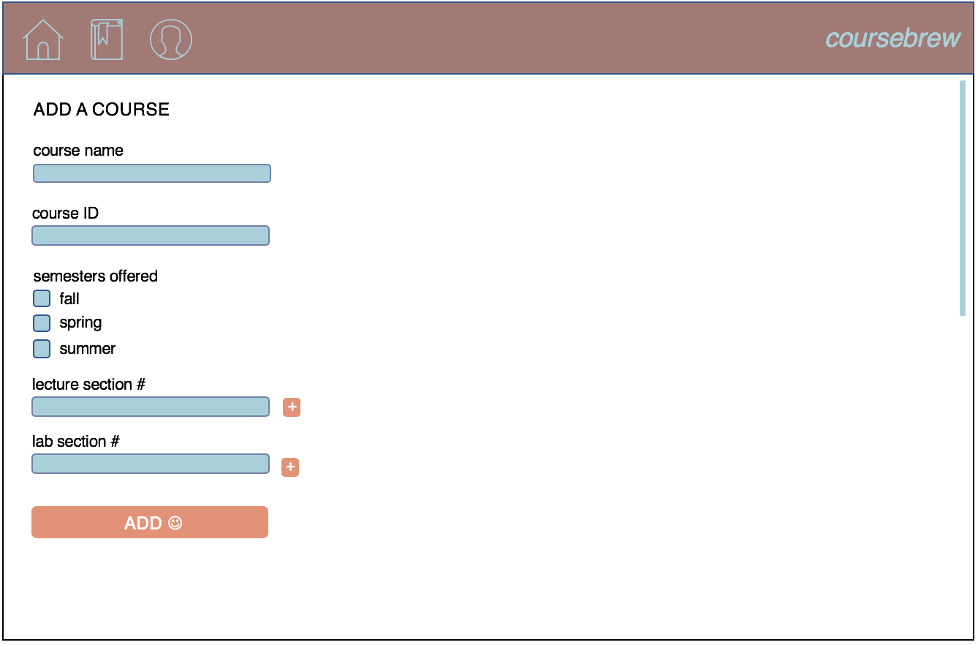
User Interface Mock-Up

Slide 6
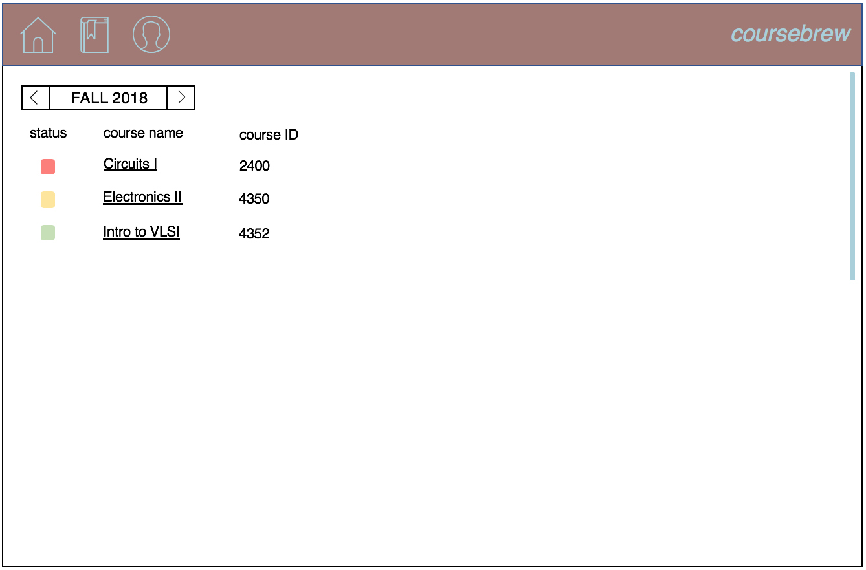
User Interface Mock-Up

Slide 7
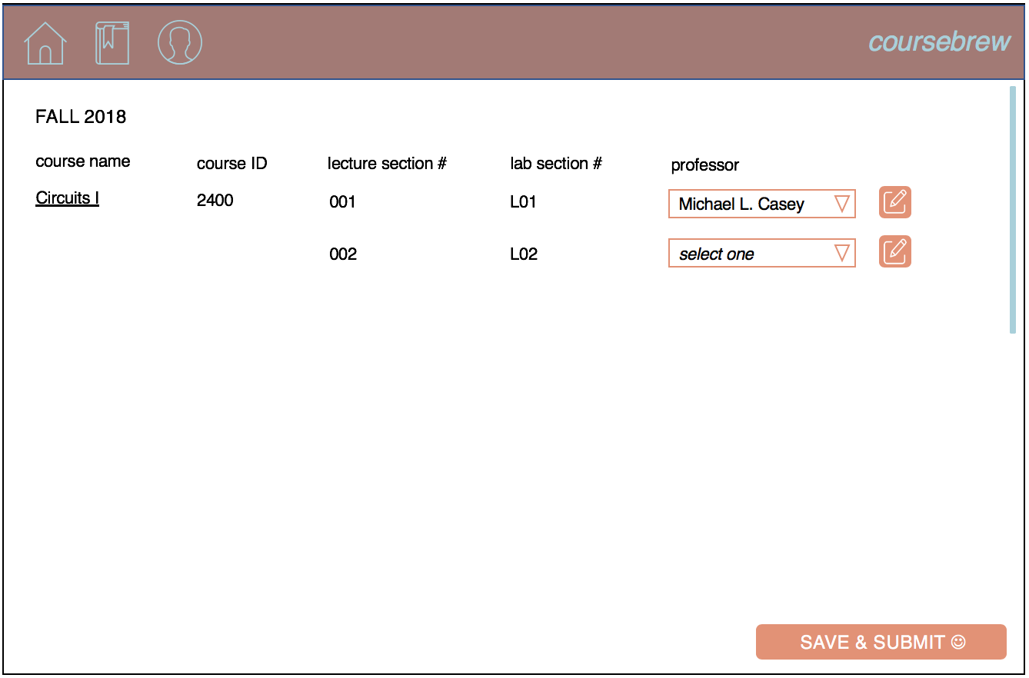
User Interface Mock-Up

Slide 8
Project Goals
Primary Goals
Stretch Goals
Design the Instructor-Course Assignment Application
Web Interface
Backend
Database
Develop and Document installation and configuration instructions
Conduct live testing with Program Coordinators to ensure usability
Implement algorithm to automatically assign instructors to courses
Implement the Class (i.e. room, time, and student count) Scheduler

Slide 9
Top-Level Diagram
User Inputs
Instructor-Course Assignment Application
System Outputs
Instructor-Course Assignments Data XML File
Course Data
Data Processing
Instructor Data
Error Notifications
Instructor-Course Assignments
Current Course, Instructor & Instructor-Course Assignments Data

Slide 10

User Inputs
Course Data
course name
course ID
semesters offered
lecture sections
lab sections
Instructor Data
instructor name
net ID
semesters teaching
track
available courses
preferred courses
Instructor-Course Assignments

Slide 11
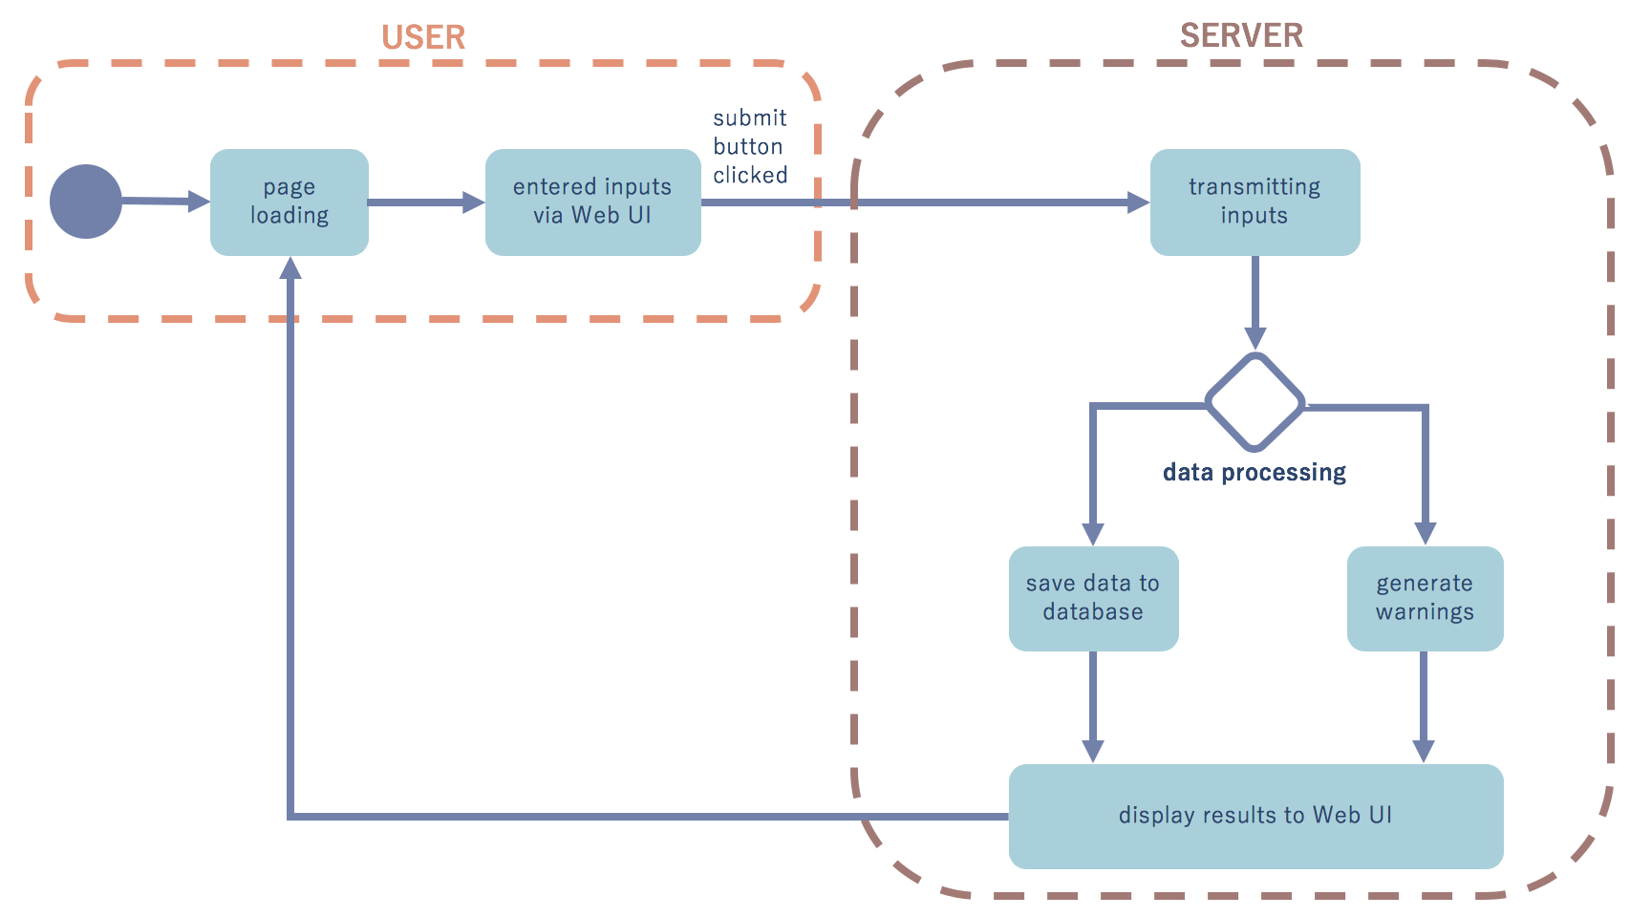
State Diagram

Slide 12
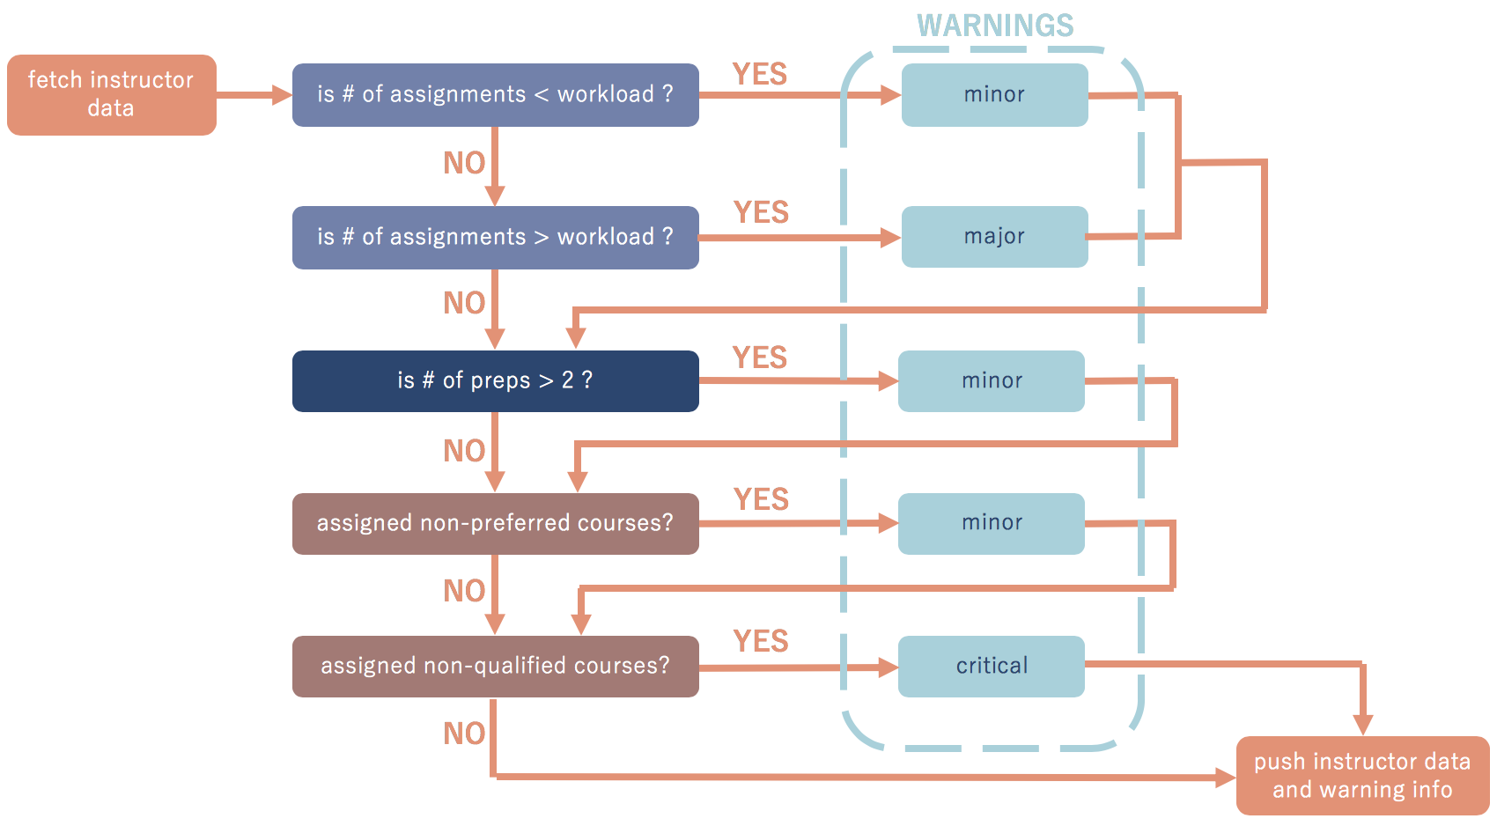
Data Processing

Slide 13




User and Administrative Functions
Program Coordinators
Directors
Administrative Assistants
System Administrators
View
View
View
View
Edit
Edit
Install
Assign
Assign
Maintain

Slide 14
Safety & Security
Since the project is purely software, physical safety isn’t a concern
Restricted access will be used to secure the data
Based on user credentials which are set by the System Administrators
System will be periodically backed up to allow for data rollback to undo mistakes

Slide 15
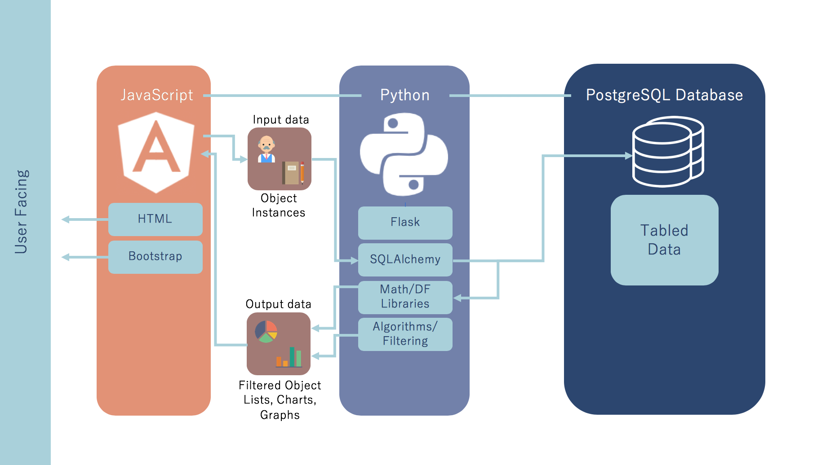
Software Interfaces

Slide 16



Error Handling
User Errors
Network Errors
Text Input Errors
JavaScript Filtering
Dead Node
HTTP Status Codes
‘404 Not Found’
Assignment
Input Errors

Slide 17
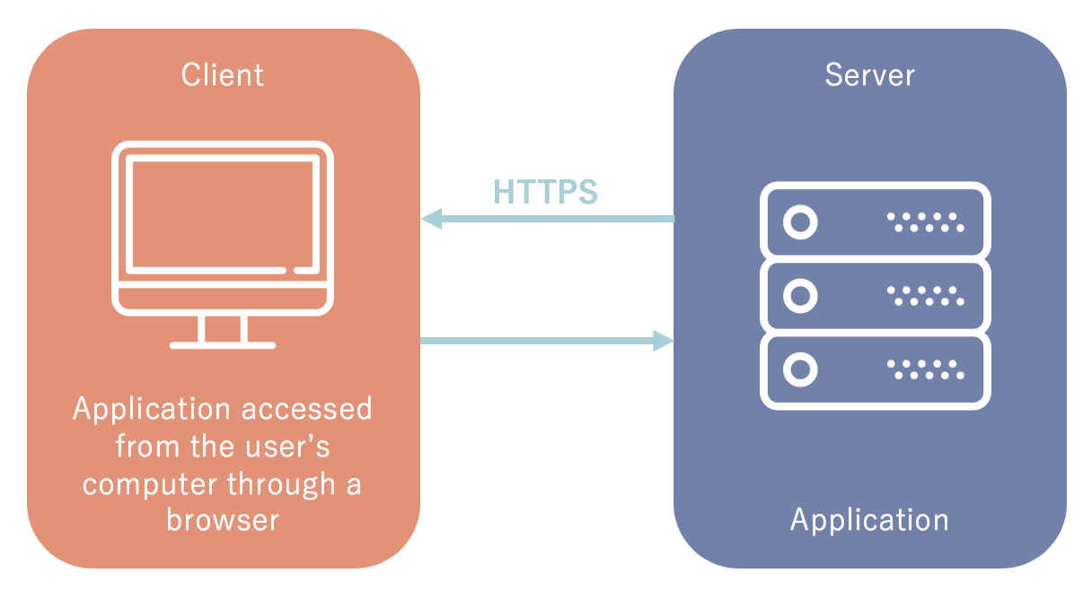
Testing Environment
Server & Client
Processor: 2.4GHz Intel Core i5-6300U (Or Equivalent)
Memory: 8GB LPDDR3 RAM
Storage: 20GB Free Drive Space
Network: An ethernet or Wi-Fi Connection
“This is the machine we have and will be using for all testing” – Hinkle 2018

Slide 18
Non-Functional Requirements
PARAMETER | REQUIREMENT | TEST METHOD
Response Time | 50ms response | Check response time in browser dev tools
Memory Usage | Less than 500MB | Use operating system task tools to check memory usage
Security | Binary | Check data stream with middleman application
Stability | Binary | Use a “monkey test” to brute-force the UI

Slide 19
Functional Requirements
FUNCTION | TEST METHOD
View Courses | Unit Testing Use scripts to automate functions and inputs Retrieve data from database and compare to inputs Manual inputs to test the UI Observe the UI to ensure that it reflects the inputs
Add a Course
Edit a Course
View Instructors
Add an Instructor
Edit an Instructor
Make Instructor-Course Assignments

Slide 20
Boundary Conditions & Constraints
Time Constraint: A Beta version must be completed by December to allow for effective testing
Stability: The system must be designed to recover a hard-stop or loss of power
Security: The data transfer must be encrypted or in some way secured to preserve privacy and confidentiality

Slide 21
Expandability, Customization, And Maintenance
Currently, the system must interface with UniTime, however the system may be expanded to replace UniTime as a stretch goal
The system can be easily modified because of its modularity: User Interface, Error and Input Processing, Database/Storage
Since the system is modularly designed, maintenance and updates can be pushed to individual parts of the system, and should not disrupt the overall performance or stability

Slide 22
Modular Design
Modular, Object Oriented Programming
server request
homepage
instructors class
instructor class
instructors
router-service
instructors.html
instructors.css
courses
warnings

Slide 23
Challenges & Concerns
Working with Texas State’s IT department to arrange for a server to be used to host our software
Have already set up our own testing environment
Deciding what constitutes a secure log in system and creating it
Using existing system such as AWS (Amazon Web Services)

Slide 24
Project Deliverables
Frontend Software
Accessible via web-browser
Features:
Add an instructor
Add a course
Make instructor-course assignments
Backend Software
Features:
Processes data
Exports XML file
“How To” Guides for:
Users
System Administrators

Slide 25
Project-Specific Milestones
MILESTONE | COMPLETION DATE | PERSON(S)
Completed theoretical design | 09/26/2018 | Kiana, David, Phillip
Set up testing environment | 10/03/2018 | Phillip
Designed & implemented rough UI | 10/29/2018 | Kiana, Phillip
Implemented database schema | 10/29/2018 | David, Phillip
Finalize beta software | 11/28/2018 | Kiana, David, Phillip
Deploy software on a stable environment for Sponsor testing | 12/05/2018 | Kiana, David, Phillip
Refine the system based on Sponsor testing | 03/05/2019 | Kiana, David, Phillip
Finalize the system, create User and Administrative documentation | 04/05/2019 | Kiana, David, Phillip

